Slide 1
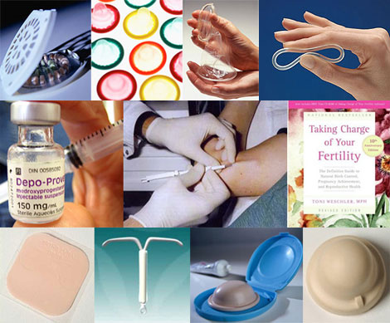
Postpartum Contraception
Prof N Palaniappan
Chennai

Slide 2
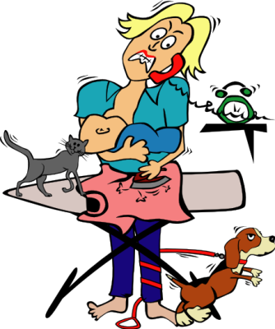
No women is completely free unless she has control over her own reproductive destiny
Margaret Sanger USA

Slide 3

Breast Feeding
Abstinence

Slide 4
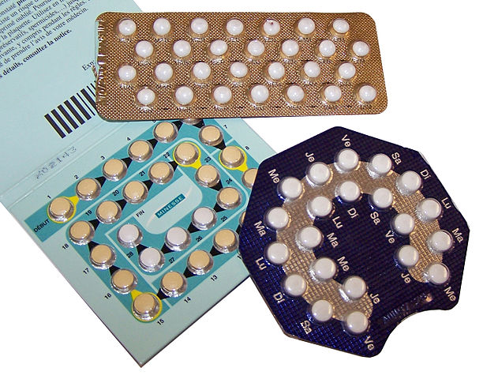
PROGESTERONE ONLY PILLS
Cerazette® Desogestrel 75
Femulen® Etynodiol diacetate 500
Micronor® Norethisterone 350
Norgeston Levonorgestrel 30
Noriday® Norethisterone 350

Slide 5
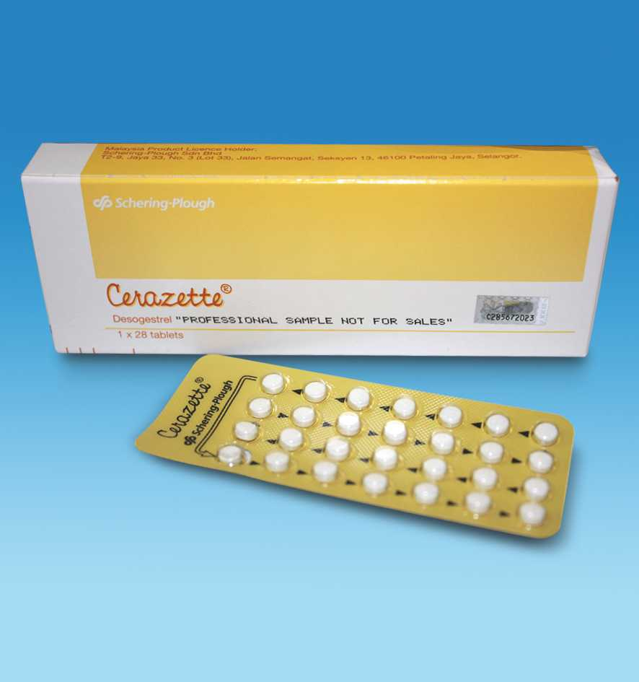

A POP with a difference: oral desogestrel
Estrogen-free contraception
75 μg desogestrel per day
Continuous oral regimen

Slide 6
POPs: Mechanisms of Action
Suppress ovulation
Reduce sperm transport in upper genital tract (fallopian tubes)
Change endometrium making implantation less likely
Thicken cervical mucus (preventing sperm penetration)

Slide 7
POPs: Contraceptive Benefits
Effective when taken at the same time every day (0.05–5 pregnancies per 100 women during the first year of use)
Immediately effective (< 24 hours)
Pelvic examination not required prior to use
Do not interfere with intercourse
Do not affect breastfeeding
Immediate return of fertility when stopped

Slide 8

POPs: Contraceptive Benefits
Few side effects
Convenient and easy-to-use
No bone loss as with depot provera
Can be provided by trained nonmedical staff
Contain no estrogen

Slide 9

POPs: Noncontraceptive Benefits
May decrease menstrual cramps
May decrease menstrual bleeding
May improve anemia
Protect against endometrial cancer
Decrease benign breast disease
Decrease ectopic pregnancy
Protect against some causes of PID

Slide 10

POPs: Limitations
Cause changes in menstrual bleeding pattern
Some weight gain or loss may occur
User-dependent (require continued motivation and daily use)
Must be taken at the same time every day
Forgetfulness increases method failure
Effectiveness may be lowered when certain drugs for epilepsy (phenytoin and barbiturates) or tuberculosis (rifampin) are taken
Do not protect against STDs (e.g., HBV, HIV/AIDS)

Slide 11
POPs: Conditions Requiring Precaution (WHO Class 3)
POPs are not recommended unless other methods are not available or acceptable if woman:
  Is breastfeeding (< 6 weeks postpartum)
  Has unexplained vaginal bleeding (only if serious problem suspected)
  Has breast cancer (current or history)
  Is jaundiced (active, symptomatic)
  Is taking drugs for epilepsy (phenytoin and barbiturates) or tuberculosis (rifampin)
  Has severe cirrhosis
  Has liver tumors (adenoma and hepatoma)
  Has had a stroke
  Has ischemic heart disease (current and history of)

Slide 12

POPs: Conditions for Which There Are No Restrictions
Blood pressure (< 180/110)
Diabetes (uncomplicated or < 20 years duration)
Pre-eclampsia (history of)
Smoking (any age, any amount)
Surgery (with or without prolonged bed rest)
Thromboembolic disorders
Valvular heart disease (symptomatic or asymptomatic)

Slide 13

POPs: When to Start
Day 1 of the menstrual cycle
Anytime you can be reasonably sure the woman is not pregnant
Postpartum:
  after 6 months if using lactational amenorrhea method (LAM)
  after 6 weeks if breastfeeding but not using LAM
  immediately or within 6 weeks if not breastfeeding
Postabortion (immediately)

Slide 14

Oral desogestrel - negligible effects
Metabolic parameters
Hemostasis
Lipid metabolism
Carbohydrate metabolism

Slide 15
POP
There is no evidence that the efficacy of progestogen-only pills (traditional or desogestrel-only) is reduced in women weighing >70 kg and therefore the licensed use of one pill per day is recommended. (Grade B)
Women may be advised that if a traditional progestogen-only pill is more than 3 hours late or a desogestrel-only pill is more than 12 hours late they should:
– take the late or missed pill now
– continue pill taking as usual (this may mean taking two pills at the same time)
– use condoms or abstain from sex for 48 hours after the pill is taken. (Grade C)

Slide 16
If a woman vomits within 2 hours of pill taking another pill should be taken as soon as possible (Grade C)
Women using liver enzyme-inducing medications short term should be advised to use condoms in addition to progestogen-only pills and for at least 4 weeks after the liver enzyme-inducer is stopped. (Grade C)
Women using liver enzyme-inducing medications long term should be advised that the efficacy of progestogen-only pills is reduced and an alternative contraceptive method should be considered. (Grade C)

Slide 17
Women may be advised that there is no evidence of a causal association between progestogen only pill use and weight change
Women should be advised that mood change can occur with progestogen-only pill use but there is no evidence of a causal association for depression. (Grade C)
Women should be advised that there is no evidence of a causal association between the use of a progestogen-only pill and headache. (Good Practice Point)

Slide 18
There is no causal association between progestogen-only pill use and cardiovascular disease (MI, VTE and stroke) or breast cancer. (Grade B)
Women may be advised that a progestogen-only pill can be continued until the age of 55 years when natural loss of fertility can be assumed.
Alternatively they can continue using a POP and have FSH concentrations checked on two occasions 1–2 months apart

Slide 19
Injectable Contraceptives

Slide 20
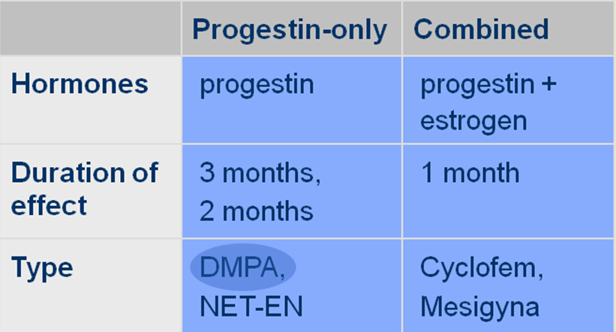
Types

Slide 21
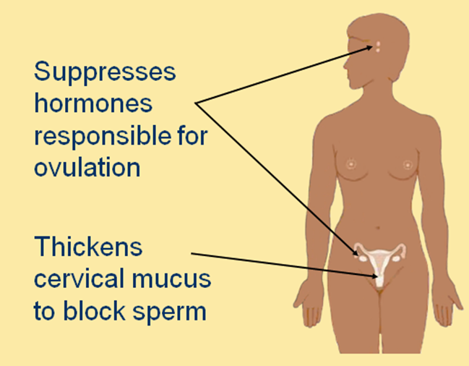
DMPA - Mechanism of Action

Slide 22
DMPA – Widely used Injectable
Best known as Depo – Provera
Used by more than 14 million women worldwide
Administered by deep intramuscular injection
150 mg every 3 months
Injection site : upper arm or buttocks

Slide 23

When to Initate
Anytime during menstrual cycle if provider is reasonably sure woman is not pregnant
  Backup recommended if given after day 7
Postpartum
  Not breastfeeding immediately
  Breastfeeding delay 6 weeks
Post abortion immediately

Slide 24

Advantages
Safe
Highly effective
Easy to use
Long acting
Reversible
Can be discontinued without provider’s help
Can be provided outside of clinics
Requires no action at the time of intercourse
Use can be private
Has no effect on lactation
Has no contraceptive health benefits

Slide 25

Non Contraceptive Heath Benefits
DMPA use may reduce
  Risk of endometrial cancer
  Risk of ectopic pregnancy
  Risk of symptomatic pelvic inflammatory disease
  Uterine fibroids
  Frequency and severity of sickle cell crises
  Symptoms of endometriosis

Slide 26
Disadvantages
Causes side effects, particularly menstrual changes
Action cannot be stopped immediately
Causes delay in return to fertility
Provides no protection in STIs/HIV

Slide 27
DMPA – Common side effects
Menstrual changes
  Prolonged or heavy bleeding
  Irregular bleeding or spotting
  Amenorrhea (absence of menses)
Weight gain
Headache, dizziness, changes in mood and sex drive
One third of users discontinued during the first year because of side effects

Slide 28
DMPA – Return to Fertility
Does not permanently reduce fertility
Length of time DMPA was used makes no difference
Return to fertility depends on how fast woman fully metabolizes DMPA
  On average, it takes 9 to 10 months for women to become pregnant after their last injection

Slide 29
Infant exposures to DMPA through Breastfeeding
DMPA has no effect on
  Onset or duration of lactation
  Quantity or quality of breast milk
  Health and development of infant
When to initiate
  After child is 6 weeks old (preferred)

Slide 30
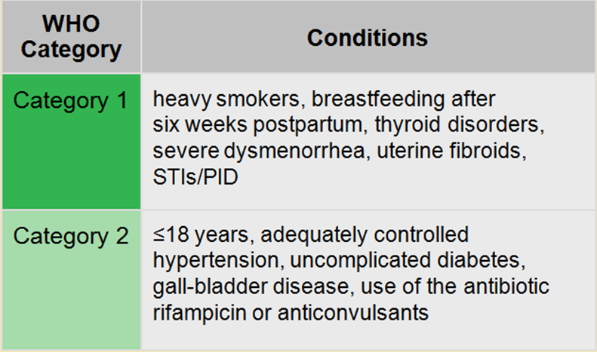
Who can use DMPA
Source: WHO, 2004

Slide 31
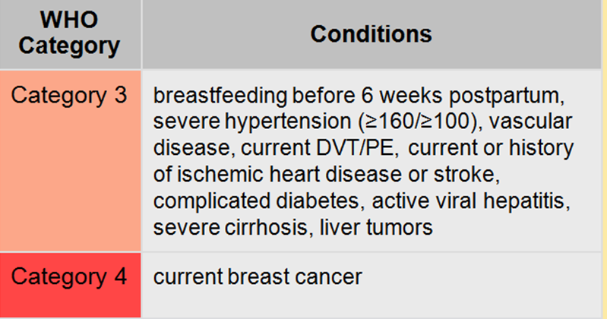

Slide 32
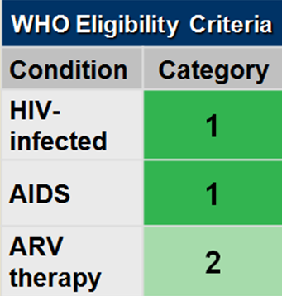
DMPA use by women with HIV
Women with HIV or AIDS can use without restrictions
Nevirapine reduces blood progestin level by ~ 20%
DMPA dose provides wides margin of effectiveness
On time injections encouraged
Dual method use should be encourages

Slide 33
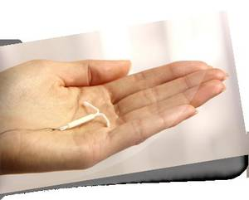
Post partum IUCD

Slide 34
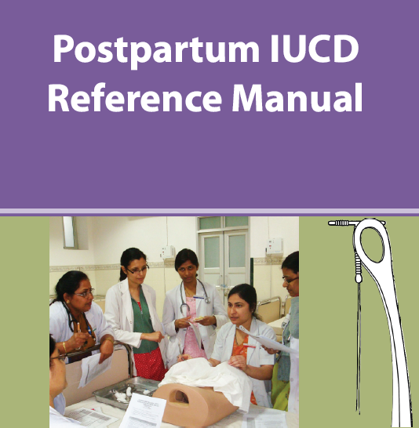


Slide 35
Types of Insertion
Post Placental Insertion :
  Insertion of IUD within 10 min of the delivery of the placenta.

Slide 36
Types of Insertion
Intra cesarean Insertion :
  Done manually / instrumental
  Insertion before uterine closure
  No need to pass the string through the Cx os (infection , displace IUD)
  No need to fix with ligature

Slide 37
Types of Insertion
Immediate Post partum :
  With in 48 hrs following delivery
  Can use regular ring forceps
Extended Post partum/ Interval insertion :
  After 6 wks of delivery
  Similar to regular IUD insertion.

Slide 38
Immediate post abortal IUD insertion
Safe and practical.
Expulsion rates were higher after second-trimester abortions than after earlier abortions,
So delaying insertion may be advisable after later abortions..
Post abortion insertion - major reduction in pregnancy -cost effective
Cochrane Database review 2004

Slide 39

Timing of Insertion
UNITED NATIONS POPULATION INFORMATION NETWORK (POPIN) with support from the UN Population Fund (UNFPA)
Because of expulsion risks, insertion ideally should take place soon after delivery, or delayed for weeks.
US agency -
Cu T - as early as 4 wks others -6wks

Slide 40
Immediate vs Delayed Insertion
A t 6 months the two groups were similar in
  Pregnancy prevention (same)
  Continuation [84% vs 77%,) OR - 1.65
  Expulsion more in the immediate than in the delayed group (OR 6.77)
RHL WHO 2010

Slide 41
IUD insertion during post partum period - A systematic Review
Search till Dec 2008
297 articles , 15 included for review
All included Cu T, no studies with LNG identified
Contraception 2009

Slide 42
Results
Immediate PP insertion - safe than late PP
Immediate - low expulsion risk than late
But more than interval insertion
Post LSCS - low expulsion than Immediate insertion
No Increase in risk of complications

Slide 43
Techniques
2 techniques -
  Instrumental Insertion - using Placental forceps
  Manual insertion- IUD held in hand

Slide 44
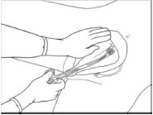

Types of Insertion
Instrumental Insertion
Manual Insertion

Slide 45
A comparative study of two techniques used in immediate postplacental insertion (IPPI) of the Copper T-380A IUD in Shanghai, People's Republic of China.
Two different insertion techniques do not significantly affect discontinuation rates IPPI using the TCu 380A,
Cu T380A appears to be suitable for postpartum insertion in Chinese women
Xu Rivera et al Contraception

Slide 46
Cochrane Review 2007
Modifications of existing device with absorbable sutures or additional appendages - NOT BENEFICIAL
No difference with hand or Instrumental Insertion
Lippes loop & Progestesert - not better than CU containing device

Slide 47
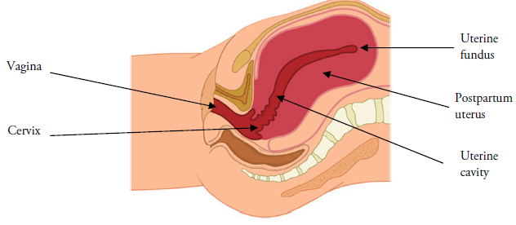
Anatomy of Post Partum Uterus

Slide 48
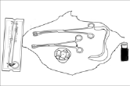
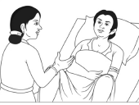
Insertion Technique
Proper Instruments
Confirm

Slide 49
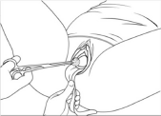
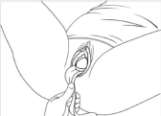
Visualise R/o
Active bleed
Cervix held with ring forceps

Slide 50
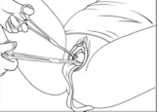
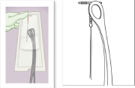
Grasp the IUD with Forceps
Insertion

Slide 51
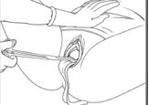
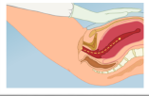
Straighten the Angle
Traction
Straighten the Angle

Slide 52
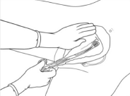
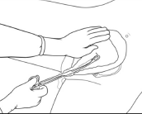
Process of Insertion

Slide 53
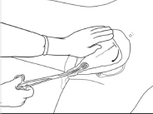
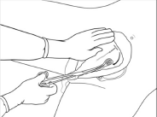
Removal of Ring Forceps

Slide 54
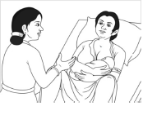
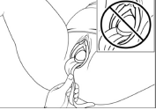
Inspect
Post procedure Counseling

Slide 55
Advantages - women
Convenience - saves time & additional visit
Safe, sure she is not pregnant
High motivation
Decreased - risk of perforation ( post placental)
Decreased perception of initial side effects
No effect on breast feeding.
Patient has effective method of contraception before discharge.

Slide 56
Post Insertion - problems
  Changes in menstrual bleeding pattern
  Cramps
  Infection
  IUD string problems
  Expulsion - partial / Complete
  Pregnancy

Slide 57
Complications
Expulsion rate : 7-15/HW at 6m ,
Risk of Infection: 0.1-1.1/HW
Perforation rate : 1 in 1150
Removal for bleeding : 13.7 vs 23.6/HW
No increase in risk of Infection, bleeding, perforation, endometritis
Does not affect Involution
      Chi et al 4th Int conf on IUD

Slide 58
Expulsion rates
Depends on
Clinician experience - special training
Skilled clinicians have been associated with lower expulsion rates than unskilled clinicians.
Contraception 1985;

Slide 59
Tips to reduce spontaneous expulsion
Right technique :
Elevate the uterus
Place IUD at fundus
Sweep the instrument to the side of uterine cavity
Keep placental forceps closed while going in & open while out

Slide 60
Tips to reduce spontaneous expulsion
Right Instrument :
Long to reach the fundus
Fenestrated.
Right time :
Post placental & Intra cesarean - to reduce expulsion rate.

Slide 61
Post-partum bleeding and infection after post-placental IUD insertion
Post-placental insertion appears to be a convenient approach to IUD initiation,
No observed increase in the incidence of excessive bleeding or endometritis.
Contraception 2001

Slide 62
Special situations
PPH :
Priorities to achieve hemodynamic stability
Insert once h’rage is controlled / next day
Insert prior to suturing episiotomy
AMTSL:
Need not be modified
Doesn’t increase risk of expulsion.

Slide 63
Breast feeding
Not affected
With Cu T380A, breast feeding women have less pain at insertion & lower removal rates than non breast feeding women
      Farr et al Am J Obstet Gynecol 1996

Slide 64
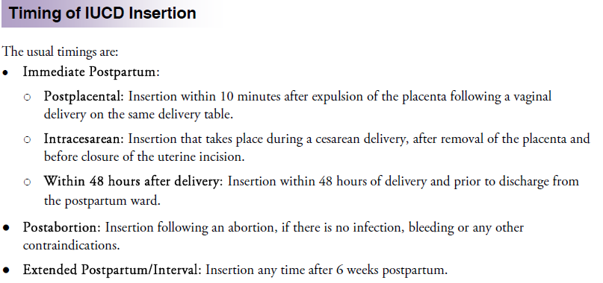

Slide 65

Conclusions
Postpartum is a right time for counselling
Choice of contraception is wide
It should suit the couple
3 accepted methods are POP, IUCD and INJECTABLES
All have their own pros & cons

Slide 66

It is essential to save the fragile ecosystem of planet earth and prevent mankind from becoming his own executioner . With the population of the world currently increasing a quarter of a billion each day , we have not a moment to lose.
SHORT 1994

Slide 67

WOMEN
They are our mothers & daughters
Our sisters & wives
They are our friends, our partners
Our strength & conscience
They guide us , nurture us
And protect us

Slide 68

TO AWAKEN PEOPLE
IT IS THE WOMEN WHO MUST BE AWAKENED
ONCE SHE IS ON THE MOVE
THE FAMILY MOVES
THE VILLAGE MOVES
THE NATION MOVES

